Slide 1
Model 2 Introduction to Cryptography
Lesson 2: Symmetric and Asymmetric Cryptography

Slide 2
Module 2: Introduction to Cryptography
Module Description:
This module provides an overview of cryptography. Students will be given an overview at first, such as different encryption methods. Then more details will be provided on symmetric cryptography and asymmetric cryptography, such as DES, AES, RSA. Another micro module talks about cryptographic applications that are widely used in the real world.
Topics:
Lesson 1: Cryptography Overview
Lesson 2: Symmetric and Asymmetric Cryptography
Lesson 3: Cryptographic Applications

Slide 3
Lesson 2: Symmetric and Asymmetric Cryptography
Topics:
DES, Double DES, Triple DES, AES, RSA
Learning Outcomes:
Upon completion of this lesson:
Students will be able to understand the differences between symmetric and asymmetric algorithms.
Students will be able to demonstrate which cryptographic techniques are appropriate for a given situation.

Slide 4
Warm up
What is the length of the key in AES?

Slide 5
Symmetric Key Algorithms
Involve using one key for both encryption and decryption
Two popular symmetric key algorithms in use today
DES – Data Encryption Standard
AES – Advanced Encryption Standard

Slide 6
DES Algorithm history
DES (Data Encryption Standard)
In 1970’s US National Bureau of Standards (NBS) recognized the need of a secure encryption technology to protect sensitive information
In 1972, NBS issued a call for proposals for producing a public encryption algorithm
Few Organizations responded to NBS call
IBM responded with Lucifer algorithm (in 1974)
Final algorithm was developed by IBM for NBS – known as DES (Data Encryption Standard)
NSA analyzed the algorithm and found no major flaw
It became a standard in 1976.

Slide 7
DES Algorithm
Overview of DES
Cryptographic algorithm designed for the protection of unclassified data and published by the National Institute of Standards and Technology (NIST) in Federal Information Processing Standard (FIPS) Publication 46.
The DES performs series of bit permutation, substitution, and recombination operations on blocks containing 64 bits of data and 56 bits of key (8-bit parity)
64-bit input, 64-bit output
64 bits of input are permuted at first, and then input to a function using static tables of permutations and substitutions

Slide 8
DES Algorithm (2)
16 rounds of processing
Each cycle:
Break permuted data into two halves, 32 bits each
Key gets transformed
Key shifted left by some number and permuted
Key bits get dropped to 48 bits
Right half of data expanded to 48 bits by duplicating certain bits
Right half combined with 48 bits of key
Result is substituted for another result and condensed to 32 bits
32 bits are permuted and then combined with left half to become the new right half

Slide 9
DES Algorithm (3)
Cycles
Process iterated 16 times (rounds), each time with different set of tables and different bits from key.
Algorithm then performs final permutation, and 64 bits of output are provided.
Decryption
Decryption uses the same algorithm and same secret key
Apply the same operations key sequence in reverse order (k16, k15, ....k1)

Slide 10

Security of DES
DES key is fixed at 56 bits ($2^{56}$ keys)
Not considered long by today’s standards
Exhaustive key search is easy with today’s computers

Slide 11
Double DES
Researchers suggested doubling DES algorithm for greater security
Double DES
In theory, using two keys should multiply difficulty, therefore making it harder to break
However, two researchers, Diffie and Hellman showed that two encryptions cannot make the increase the difficulty a lot.
The strength of Double DES is similar to using 57-bit key.

Slide 12
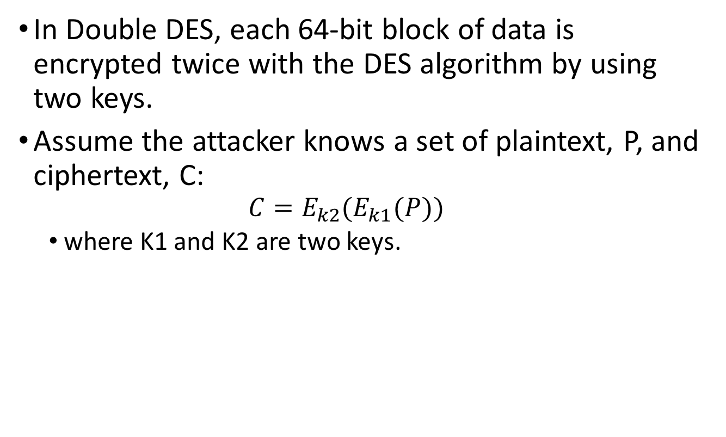
Double DES
In Double DES, each 64-bit block of data is encrypted twice with the DES algorithm by using two keys.
Assume the attacker knows a set of plaintext, P, and ciphertext, C:
$$C=E_{k2}(E_{k1}(P))$$
where K1 and K2 are two keys.

Slide 13
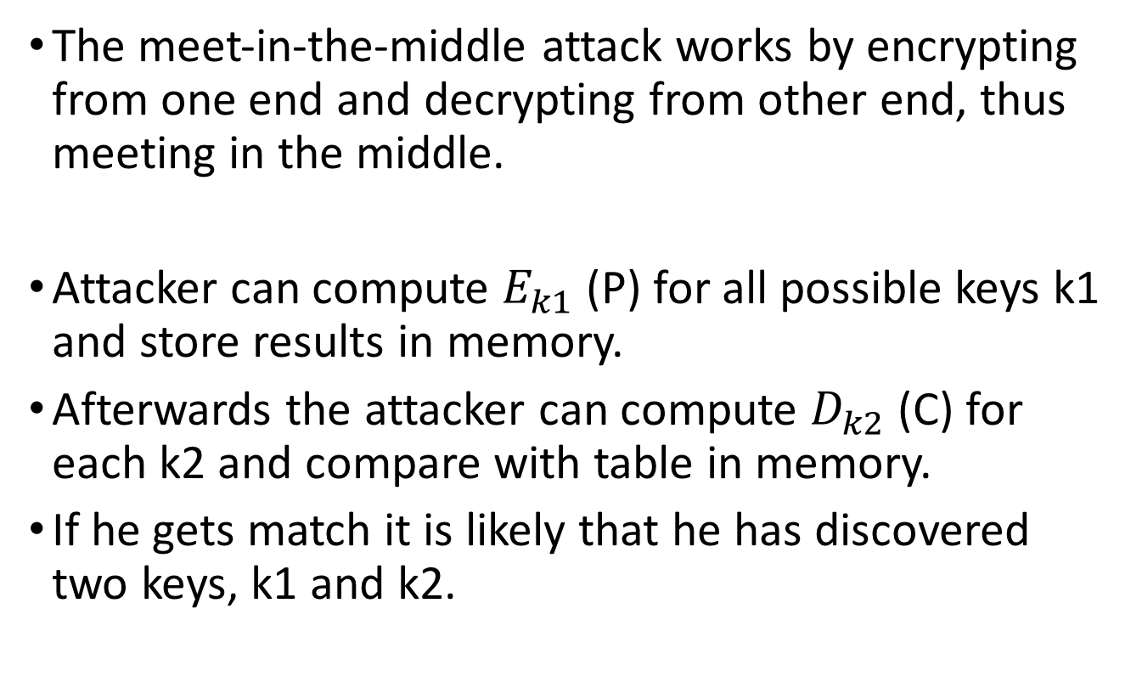
meet-in-the-middle attack
The meet-in-the-middle attack works by encrypting from one end and decrypting from other end, thus meeting in the middle.
Attacker can compute $E_{k1}$(P) for all possible keys k1 and store results in memory.
Afterwards the attacker can compute $D_{k2}$(C) for each k2 and compare with table in memory.
If he gets match it is likely that he has discovered two keys, k1 and k2.

Slide 14
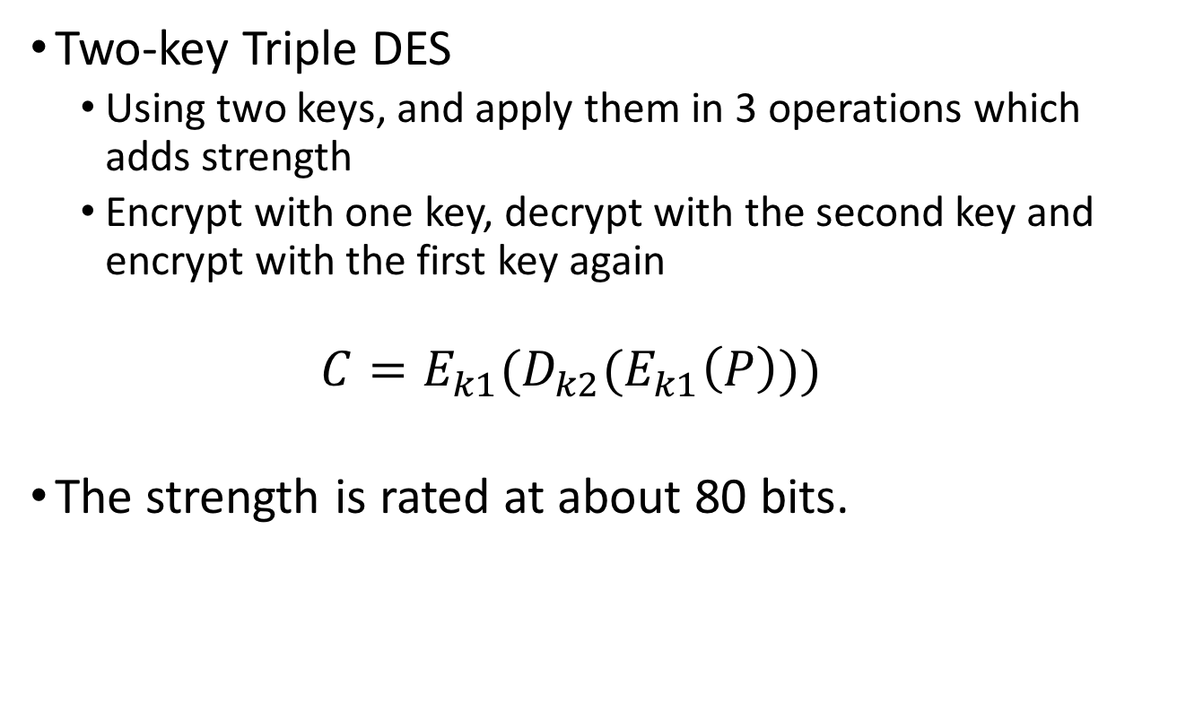
Two-key Triple DES
Two-key Triple DES
Using two keys, and apply them in 3 operations which adds strength
Encrypt with one key, decrypt with the second key and encrypt with the first key again
$$C={E_{k1}(D}_{k2}(E_{k1}\left(P\right)))$$
The strength is rated at about 80 bits.

Slide 15
Three-key Triple DES
Triple DES
Using three keys, apply them in 3 operations which adds strength
Encrypt with one key, decrypt with the second key and encrypt with the third key
Three applications of the DES algorithm but it only doubles the effective key length – 112-bit key

Slide 16
DES Weak keys
DES uses 16 48-bits keys generated from a master 56- bit key (64 bits if we consider also parity bits)
Weak keys: keys make the same sub-key to be generated in more than one round.
Result: reduce cipher complexity
Weak keys can be avoided at key generation.
DES has 4 weak keys
01010101 01010101
FEFEFEFE FEFEFEFE
E0E0E0E0 F1F1F1F1
1F1F1F1F 0E0E0E0E

Slide 17
Compare DES encryptions
Encryption | Operation | Key length | Strength
DES | Encrypt with one key | 56-bit | 56-bit
Double DES | Encrypt with one key, then encrypt the result with another key | Two 56-bit keys | 57-bit
Two-key Triple DES | Encrypt with one key, then encrypt (or decrypt) the result with another key, then encrypt with the first key again | Two 56-bit keys | 80-bit
Three-key Triple DES | Encrypt with one key, then encrypt (or decrypt) the result with another key, then encrypt with the third key | Three 56-bit keys | 112-bit

Slide 18
AES Algorithm history
AES, the Beginning
In 1997, NIST (NBS became NIST) did another call for proposals for a replacement to DES.
In 1999, five finalists were selected and were tested.
Looked at security but also at cost or efficiency, ease of implementation in software
Winning algorithm submitted by two Dutch cryptographers – Vincent Rijmen and Joan Daemon
Called AES and was adopted in 2001
Became Federal Information Processing Standard 197 (FIPS 197)

Slide 19
AES Algorithm
Overview AES
Fast algorithm
Can be implemented on simple processor
Uses substitution and transposition plus shift, XOR and addition operations
Uses repeat cycles – called rounds in AES
There are 10, 12, or 14 cycles for keys of 128, 192, and 256 bits.
Each cycle consists of 4 steps

Slide 20
AES Algorithm cycle
Each cycle has four steps:
1. Byte substitution
Uses byte substitution box structure similar to DES
Substituting each byte of a 128 bit block according to a substitution table
2. Shift Row (confusion operation)
Transposition step
For 128 and 192 bit block sizes, row n is shifted left circular (n-1) bytes
For 256 bit blocks, row 2 is shifted 1 byte and rows 3 and 4 are shifted 3 and 4 bytes

Slide 21
AES Algorithm cycle (cont.)
Each cycle has four steps:
3. Mix Columns (both confusion and diffusion operations)
Shifting left and Xoring the bits with themselves
4. Add subkey (confusion)
Portion of key unique to this cycle is Xor’ed with cycle result
Steps perform both confusion and diffusion on input data
Bits from key are combined with intermediate results frequently, so key bits will be well diffused

Slide 22
Challenges
Main challenge is getting sender and receiver to agree on the secret key without knowing by anyone else.
If the secret key is known by attackers, then they can later read, modify, and forge all messages encrypted or authenticated using that key
Key management: generation, transmission and storage of keys
All keys in secret-key cryptosystem must remain secret
Secret-key cryptography often has problems with secure key management
Especially in open systems with large number of users

Slide 23
Public Key (Asymmetric) Cryptography
In order to solve the key management problem, Whitfield Diffie and Martin Hellman introduced the concept of public-key cryptography in 1976
Each person gets a pair of keys, a public key and a private key
Public key is published, while private key is kept secret
Public-key cryptosystems have two primary uses, encryption and digital signatures.
All communications involve only public keys, and no private key is ever transmitted or shared.

Slide 24
Public Key (Asymmetric) Cryptography (cont.)
Messages encrypted using the user’s public key can only be decrypted using the user’s private key, and vice versa.
Public-key cryptosystems are networks of users rather than a single pair of users
Each user in a network has a pair of keys associated with him/her (Public key & private key)
Pair of keys generated by running a key-generation algorithm, it involves complicated mathematical manipulations of large numeric numbers

Slide 25
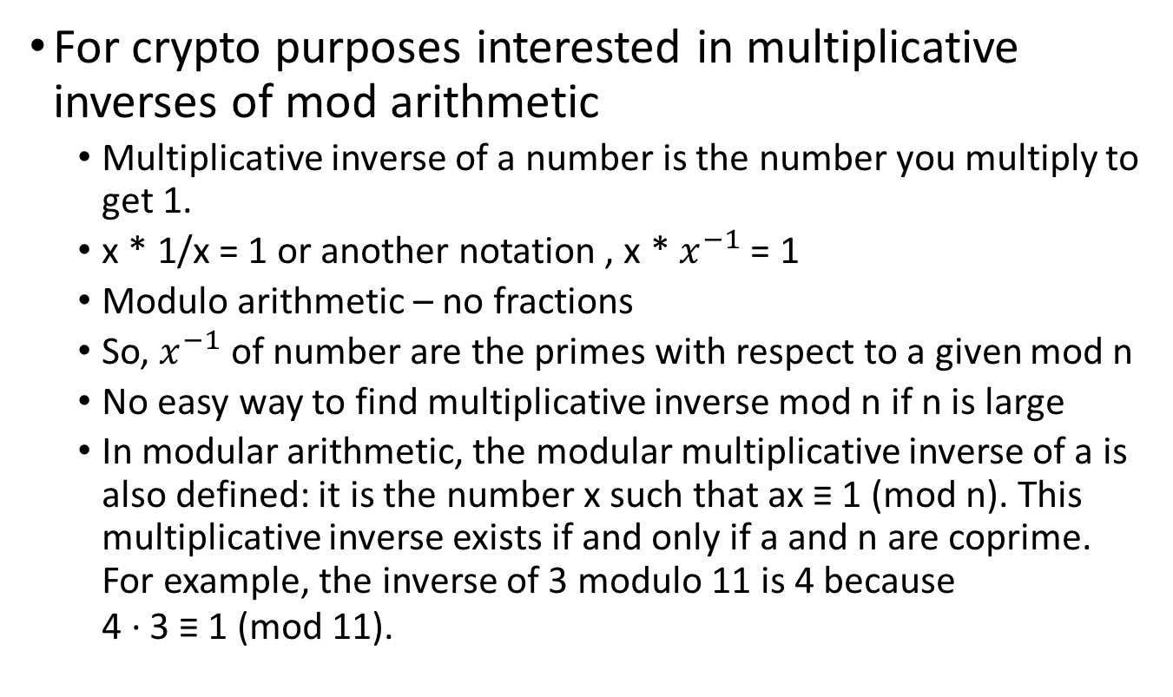
Modulo Arithmetic
For crypto purposes interested in multiplicative inverses of mod arithmetic
Multiplicative inverse of a number is the number you multiply to get 1.
x * 1/x = 1 or another notation , x * $x^{−1}$ = 1
Modulo arithmetic – no fractions
So, $x^{−1}$ of number are the primes with respect to a given mod n
No easy way to find multiplicative inverse mod n if n is large
In modular arithmetic, the modular multiplicative inverse of a is also defined: it is the number x such that ax ≡ 1 (mod n). This multiplicative inverse exists if and only if a and n are coprime. For example, the inverse of 3 modulo 11 is 4 because 4 · 3 ≡ 1 (mod 11).

Slide 26
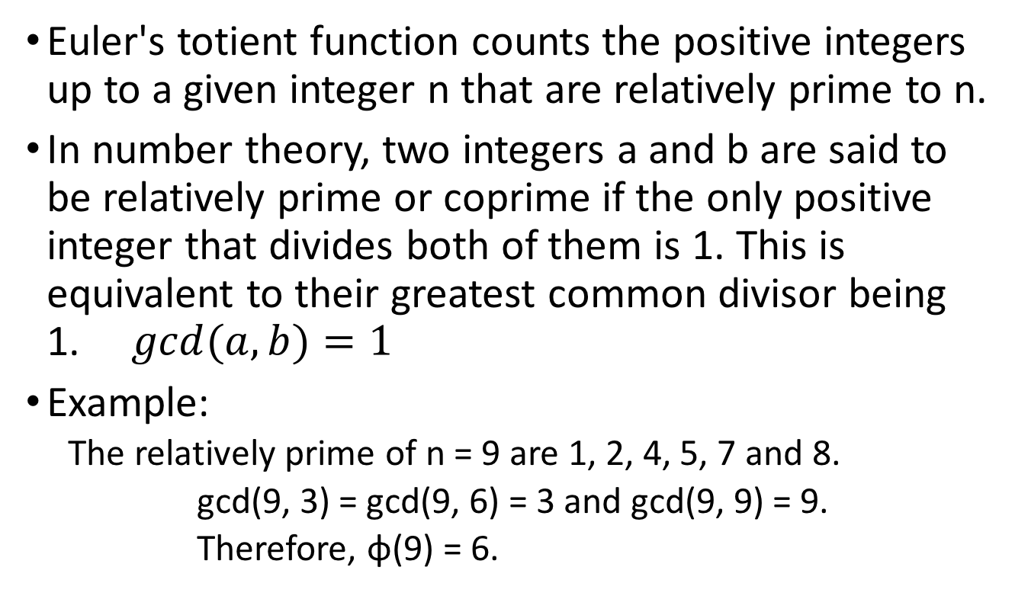
Euler's totient function
Euler's totient function counts the positive integers up to a given integer n that are relatively prime to n.
In number theory, two integers a and b are said to be relatively prime or coprime if the only positive integer that divides both of them is 1. This is equivalent to their greatest common divisor being 1. $gcd(a,b)=1$
Example:
The relatively prime of n = 9 are 1, 2, 4, 5, 7 and 8.
gcd(9, 3) = gcd(9, 6) = 3 and gcd(9, 9) = 9.
Therefore, φ(9) = 6.

Slide 27
Euler's totient function (cont.)
If n is prime, then all integers {1,2,3 ... n-1} are relatively prime to n, so φ(n) = n-1
Euler's totient function is a multiplicative function, meaning that if two numbers m and n are relatively prime, then φ(mn) = φ(m)φ(n).
If n is the product of two primes, n = pq, then
φ(n) = φ(pq) = φ(p) φ(q) = (p-1)(q-1)
Example:
φ(10) = φ(2) * φ(5) = 1 * 4 = 4 {1,3,7,9}
φ(21) = φ(3) * φ(7) = 2 * 6 = 12 {1,2,4,5,8,10,11,13,16,17,19,20}

Slide 28
RSA
The RSA Public Key Cryptography was invented by Ronald Rivest, Adi Shamir, and Leonard Adelman in 1978.
Encrypted messages can be passed from the sender to the receiver, and then decrypted by the receiver, without having to transfer a secret decryption key between them.
The public key, which can be safely published for all to know, is used to encrypt the message.
The private key, which is held by the owner, should be kept secret, is used to decrypt the message.

Slide 29
RSA encryption algorithm
Encryption algorithm
Public key is (e,n) prive key is (d,n)
c = p*e mod n and p = c*d mod n
encryption decryption
Because of symmetry in modular arithmetic, encryption and decryption are mutual inverses and commutative.
P = c*d mod n = (p*e) * d mod n = (p*d ) * e mod n
The relationship means that:
one can apply the encrypting transformation and then the decrypting one, or
apply the decryption first and then encrypt one.

Slide 30
Deriving a key pair
The encryption key consists of the pair of integers (e, n), and the decryption key is (d,n).
To find keys:
Select the value of n. (n should be large (512bits, 768bits, 1024bits or more), a product of two primes p and q.)
Choose an integer e < n, relatively prime to (p-1)*(q-1).
Find second integer d, such that
ed mod φ(n) = 1

Slide 31
Key pair
The user distributes e and n and keeps d secret
p, q, φ(n) can be discarded.
Even though n is known to be the product of two primes, if they are relatively large, it will not be easy to determine the specific primes p and q, or the private key d from e. Therefore, this scheme provides adequate security for d.

Slide 32
RSA Algorithm example
1) Generate a public Key and a Private key
Choose, two large prime numbers, p and q
for example: p = 7, q = 19
2) Let n = pq
n = 7 * 19 = 133
3) Let m = (p - 1)(q - 1) = φ(n)
m = (7 - 1)(19 - 1) = 6 * 18 = 108

Slide 33
RSA Algorithm example (cont.)
4) Choose a number, e coprime to φ(n)
e = 2 => gcd(e, 108) = 2 (no) e = 3 => gcd(e, 108) = 3 (no) e = 4 => gcd(e, 108) = 4 (no) e = 5 => gcd(e, 108) = 1 (yes!)
5) Find d, such that d*e mod m = 1 (m is φ(n))
We can rewrite this as d = (1 + nm) / e. Now we work through values of n until an integer solution for e is found:
n = 0 => d = 1 / 5 (no) n = 1 => d = 109 / 5 (no) n = 2 => d = 217 / 5 (no) n = 3 => d = 325 / 5 = 65 (yes!)

Slide 34
RSA encryption example
Encryption Example
use the message "6” (P, plaintext).
C = P * e mod n = 65 mod 133 = 7776 mod 133 = 62

Slide 35
RSA decryption example
Decryption example
P = c*d % n = 6265 % 133 = 62 * 6264 % 133 = 62 * (622)32 % 133 = 62 * 384432 % 133 = 62 * (3844 % 133)32 % 133 = 62 * 12032 % 133

Slide 36
RSA decryption example (cont.)
Continue the calculation:
= 62 * 3616 % 133 = 62 * 998 % 133 = 62 * 924 % 133 = 62 * 852 % 133 = 62 * 43 % 133 = 2666 % 133 = 6
The result matches the plaintext “6”.

Slide 37
Security of Public Key Encryption
Asymmetric algorithms require longer keys to provide same level of security as symmetric keys
512 bit RSA public key is equivalent to a 64 bit symmetric key
768 bit RSA public key is equivalent to an 89 bit symmetric key
RSA encryption for protecting very high value transactions - at least a 1024 bit or higher key SHOULD be used

Slide 38
Discussion
What are the advantages and disadvantages of symmetric cryptography and asymmetric cryptography?

Slide 39
Summary
Symmetric/private encryption
using one key for both encryption and decryption
DES – Data Encryption Standard
AES – Advanced Encryption Standard
Asymmetric/public encryption
using a pair of keys for encryption and decryption separately.
RSA

Slide 40
Please attribute Dr. Jim Alves-Foss and Dr. Jia Song, University of Idaho
Except where otherwise noted, this work is licensed under https://creativecommons.org/licenses/by-nc-sa/4.0/ Not withstanding the non-commercial license terms, non-profit educational institutions are granted a non-exclusive license to adapt and use this material, with attribution. Creative Commons and the double C in a circle are registered trademarks of Creative commons in the United States and other countries. Third party marks and brands are the property of their respective holders.
Project sponsored by the National Security Agency under grant Number H98230-17-1-0199. The United States Government is authorized to reproduce and distribute reprints notwithstanding any copyright notation herein.

